Slide 1



Branding with App model

Slide 2

Modify branding with SP Apps
Remote provisioning
Add sites, artifacts and elements to sites using CSOM to avoid dependency to feature framework
Suitable also for adding master pages and themes to sites automatically
JS injection
Apply changes to the pages using JS Injection technique
Can be used to add elements and structures to existing pages

Slide 3

How to minimize future maintenance
Use themes rather than master pages
All changes to OOB master pages are provided to your sites automatically without need to modify custom code
Avoid feature framework element usage
Many feature framework elements will create dependency to xml files, which then cannot be removed easily
Sandbox solutions will also impact future cost model of the Office365 sites

Slide 4
How to get branding to sites?

Slide 5
Same model as for other assets…
Upload needed assets to sites using CSOM from provider hosted apps…

Slide 6
How do I handle this without adding apps to each site?
How do I automate branding for sites cross my site collections and sub sites?

Slide 7
Other considerations?
App based management does not cause any downtime for SharePoint, when the assets are deployed…
You’ll have to manage some of the branding assets separately on each site collection… APIs are there though….
Reference CSS, images and JavaScript's from centralized location to make updates easier…

Slide 8
CSS

Slide 9

Adding alternative styling for host web
What
Provide alternate CSS styling elements to the web by adding custom style elements to the page rendering process
Why
To provide more comprehensive changes on the page layout compared what themes can do without introducing custom master page
How
Inject custom JavaScript to page execution process, which adds the CSS class to page rendering process or use the AlternateCSSUrl web property (introduced in April CU)

Slide 10
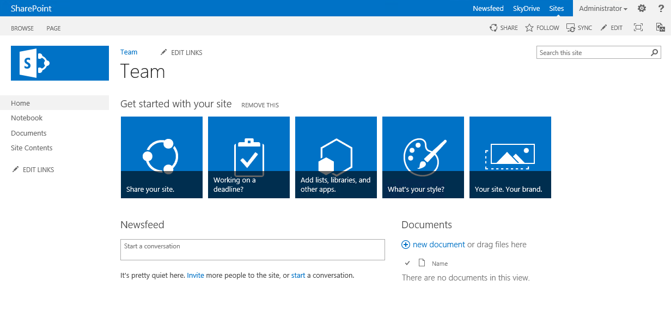
Controlling CSS from App
1
CSOM
3
Upload CSS
Set JS Injection for CSS to be executed in page process
Assets
2
Notes:
App installed or app operation moves processing to app side
App has needed assets and configurations stored somewhere
CSS injection is added to the host web by using custom user action and JS entry

Slide 11
CSS
Demo

Slide 12
Master page on non-publishing sites

Slide 13
Should you do this?
It’s strongly advised to not use a custom master pages on non-publishing pages:
Microsoft is continuously improving the Office 365 service and this means that we regularly update the existing master pages. Having your own master pages will mean that you’ll need to keep up with Microsoft’s changes in order to leverage all features and keep up with the default user experience Microsoft is offering
It’s better to use custom CSS and JavaScript to create the desired user experience

Slide 14
Controlling MasterPage from App
1
CSOM
3
Upload master page
Set site master page using CSOM
Master
2
Notes:
App installed or app operation moves processing to app side
App has needed assets and configurations stored somewhere
Master page is uploaded to master page gallery and set as site master page

Slide 15
Master Page
Demo

Slide 16
Master page and page layouts on publishing sites

Slide 17
Controlling Master page and page layouts from App
1
CSOM
3
Upload master page
Upload page layouts
Set site master page using CSOM
Set page layouts
Set allowed site templates
Master
Page layouts
2
Notes:
App installed or app operation moves processing to app side
App has needed assets and configurations stored somewhere
Master page is uploaded to master page gallery and set as site master page

Slide 18
Example code asset uploads + usage
// Deploy a master page to the master page gallery cc.Web.DeployMasterPage(HostingEnvironment.MapPath(string.Format("~/{0}", "Resources/contoso.master")), "Contoso", "Contoso master page");
// Assign master page to the host web
cc.Web.SetMasterPagesForSiteByName("contoso.master", "contoso.master");
// Create a content type which is inherited from oob welcome page using a defined ID
cc.Web.CreateContentType("ContosoWebPage", ContosoWebPageCTId,"Contoso Types");
// Upload page layouts to the master page gallery
cc.Web.DeployPageLayout(HostingEnvironment.MapPath(string.Format("~/{0}", "Resources/ContosoLinksBelow.aspx")), "Contoso Links Below", "Contoso Links Below", ContosoWebPageCTId);
// Add content type to Pages library
cc.Web.AddContentTypeToListById("Pages", ContosoWebPageCTId);

Slide 19
Example code creating a publishing page
// Solve layout and create new page
ListItem pageLayout = cc.Web.GetPageLayoutListItemByName("ContosoLinksRight.aspx");
PublishingWeb pWeb = PublishingWeb.GetPublishingWeb(cc, cc.Web);
PublishingPageInformation publishingPageInfo = new PublishingPageInformation();
publishingPageInfo.Name = "demo.aspx";
publishingPageInfo.PageLayoutListItem = pageLayout;
PublishingPage publishingPage = pWeb.AddPublishingPage(publishingPageInfo);
if (pages.ForceCheckout || pages.EnableVersioning)
{
publishingPage.ListItem.File.CheckIn(string.Empty, CheckinType.MajorCheckIn);
publishingPage.ListItem.File.Publish(string.Empty);
if (pages.EnableModeration)
{
publishingPage.ListItem.File.Approve(string.Empty);
}
}
cc.ExecuteQuery();

Slide 20
Example code limit page layouts and site templates
List<WebTemplateEntity> templates = new List<WebTemplateEntity>();
templates.Add(new WebTemplateEntity() { LanguageCode = "1035", TemplateName = "STS#0" });
templates.Add(new WebTemplateEntity() { LanguageCode = "", TemplateName = "STS#0" });
templates.Add(new WebTemplateEntity() { LanguageCode = "", TemplateName = "BLOG#0" });
cc.Web.SetAvailableWebTemplates(templates);
// Apply available page layouts
List<string> pageLayouts = new List<string>();
pageLayouts.Add("ContosoLinksBelow.aspx");
pageLayouts.Add("ContosoLinksRight.aspx");
clientContext.Web.SetAvailablePageLayouts(clientContext.Web, pageLayouts);
// Set default page layout for the site
cc.Web.SetDefaultPageLayoutForSite(clientContext.Web, "ContosoLinksBelow.aspx");

Slide 21
Example code specify content type ID
ContentTypeCollection contentTypes = web.ContentTypes;
cc.Load(contentTypes);
cc.ExecuteQuery();
foreach (var item in contentTypes)
{
if (item.StringId == "0x0101009189AB5D3D2647B580F011DA2F356FB2")
return;
}
// Create a Content Type Information object
ContentTypeCreationInformation newCt = new ContentTypeCreationInformation();
newCt.Name = "Contoso Document";
//Inherit from oob document - 0x0101 and assign
newCt.Id = "0x0101009189AB5D3D2647B580F011DA2F356FB2";
newCt.Group = "Contoso Content Types";
// Create the content type
ContentType myContentType = contentTypes.Add(newCt);
cc.ExecuteQuery();

Slide 22
Master page and page layouts on publishing sites
Demo

Slide 23
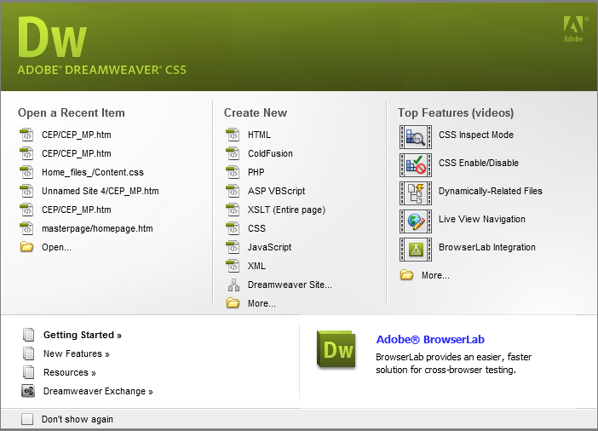

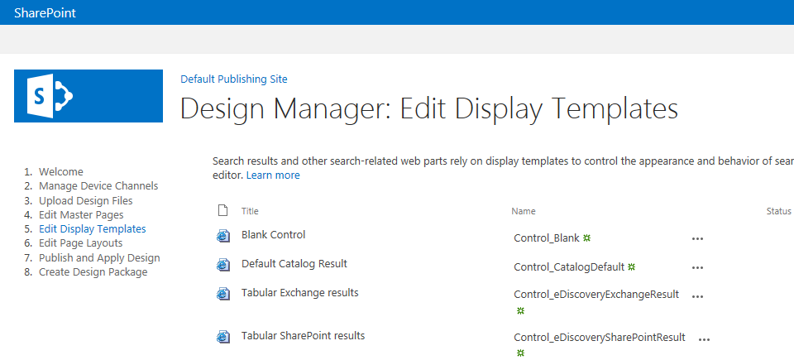
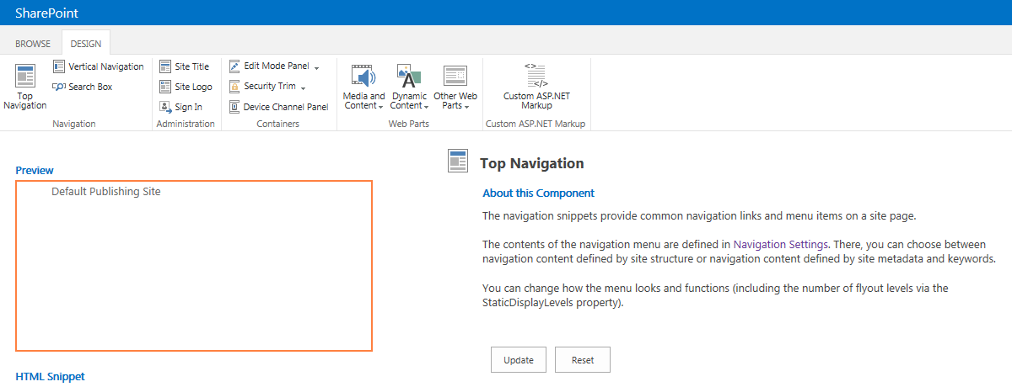
Design Manager and general rendering changes
Empowering web designers & developers
Completely revamped CSS classes
Web Part rendering with DIVs, not with TABLEs
Minimizing ramp up time
Site design & branding using the technologies web developers already know & love (HTML, CSS, JS)
Developers use their preferred design tools
Creating and updating designs no longer requires deep SharePoint expertise
Design Manager for assisting uploading templates and modifying them on-fly

Slide 24
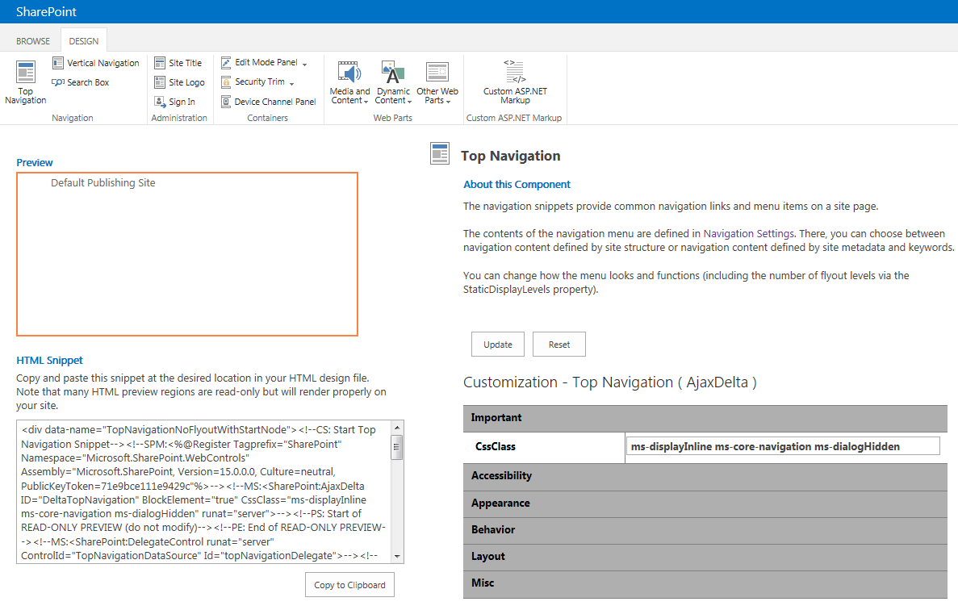
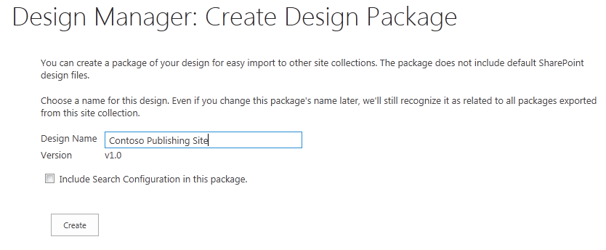
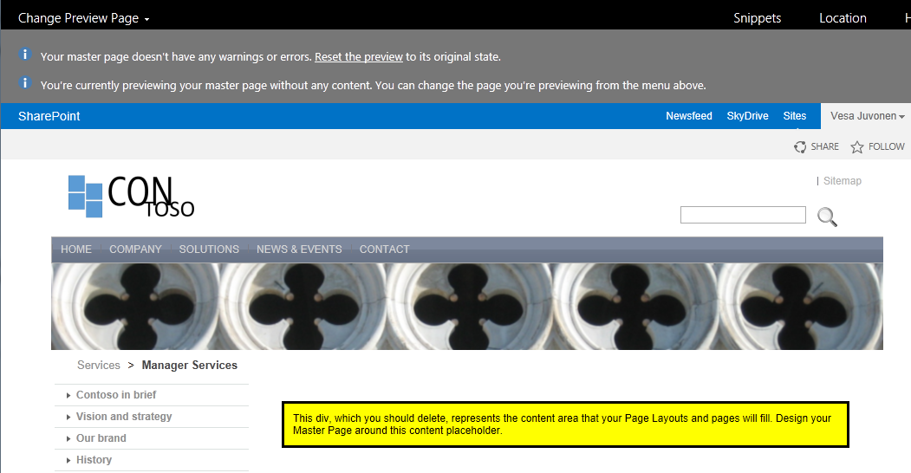
Design Manager capabilities
Provides guidance to modify master page and page layouts
Helps for converting html designs to be used in SharePoint as master pages
Editors keep updating html pages
SharePoint converts required changes for master pages and page layouts
Snippets for helping building designs
Export and Import capabilities
Packages created as Sandbox solutions which can moved cross environments

Slide 25
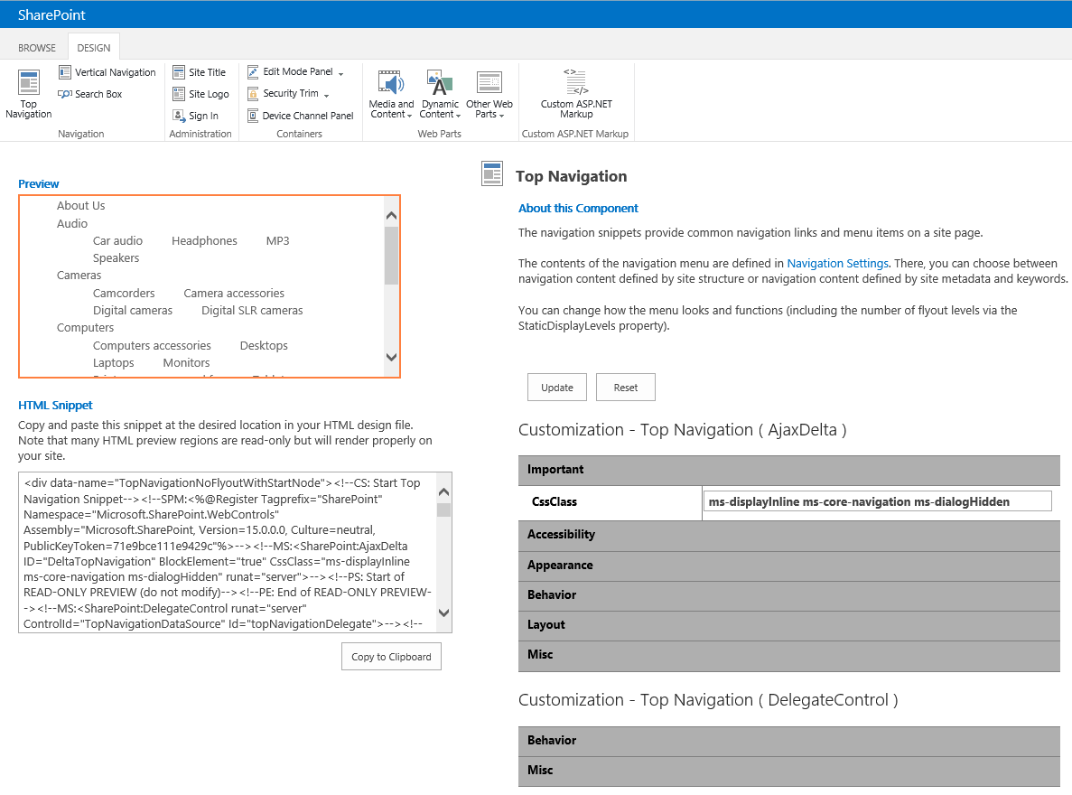
Dynamic Snippets for SP controls

Slide 26
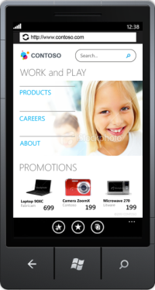
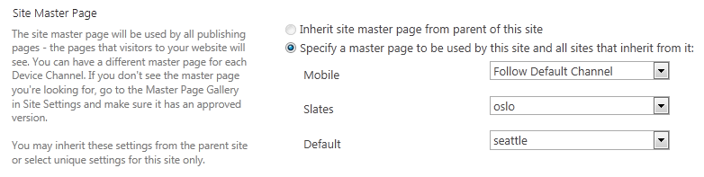
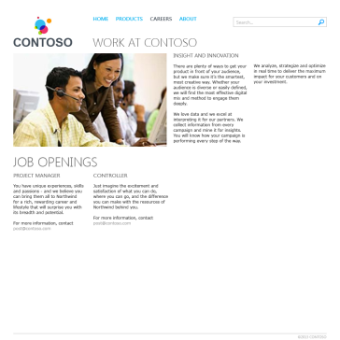
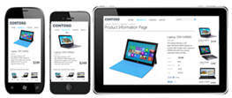
Device based rendering - Channels
Different channels defined in site collection level (SPSite)
Define “channels” for single devices or groups of devices – based on user agents
Assign alternate “Master Pages” (shared look and feel) per channel
Selectively include and exclude portions of Page Layouts per channel by using specific control
Possible to provide cookie level override for end users
Only available from publishing sites.
Same URL, different look and feel based on used device

Slide 27
SharePoint 2013 WCM CSOM
SharePoint 2013 Publishing surfaced via CSOM
Microsoft.SharePoint.Client.Publishing.dll
Current capabilities
Add publishing pages to site
Create site image renditions
Read variation information
Install DesignPackage
Control taxonomy driven navigation (taxonomy CSOM also needed)

Slide 28
Example installation of DesignPackage
private static void ApplyDesign(ClientContext context, string fileUrl)
{
if (context.IsSiteFeatureActivated(PublishingFeature))
{
DesignPackageInfo info = new DesignPackageInfo()
{
PackageGuid = Guid.Empty, MajorVersion = 1, MinorVersion = 1, PackageName = "Bootstrap"
};
Console.WriteLine("Installing design package ");
string fileRelativePath = GetSiteRelativePath(context.Url) + fileUrl;
DesignPackage.Install(context, context.Site, info, fileRelativePath);
context.ExecuteQuery();
Console.WriteLine("Applying Design Package!");
DesignPackage.Apply(context, context.Site, info);
context.ExecuteQuery();
}
}

Slide 29
Design manager or not?
Design packages are actually WSP packages that are deployed like sandboxed solutions
When packages get bigger you’ll be facing activation timeouts and other complications related on the feature framework usage
Recommend option: Use design manager during development / design time, push the elements to sites using CSOM

Slide 30
Theme

Slide 31
Themes
What
Provide user branding elements without introducing master page or page layout elements
Why
Continue using out of the box master pages, but introduce customer specific branding elements
How
Use theming engine for introducing master page, color, fonts and background image for sites

Slide 32
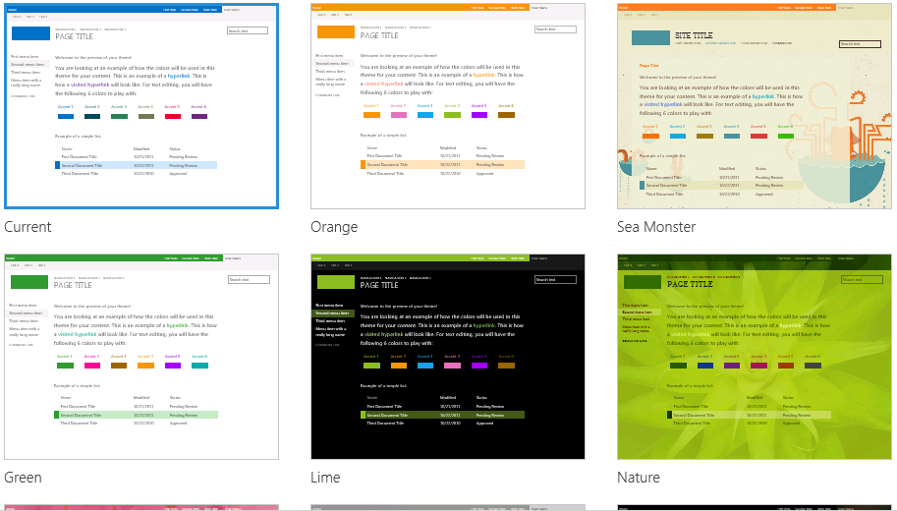
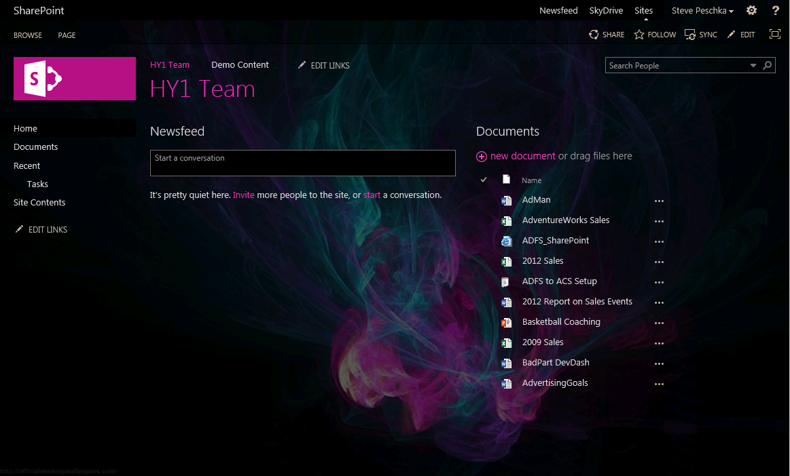
Theming Experience
What the theme experience looks like now:
Sample site based on a customized theme:
Notes:
Here are a couple of examples of what the theming experience looks like in SharePoint 2013. On the left side of the page you see the theme thumbnail gallery. It displays the out of the box themes that you can use as is, or you can customize them to look exactly like you want. On the right hand side of the page is an example of a site that has had a custom theme applied. In this case we just started with an out of the box theme, spent about 2 minutes customizing the layout, background picture, colors and fonts and that was it – we were ready to go. You can see how quickly you can make a site that doesn’t look anything like SharePoint if you want.
******************************
From my testing

Slide 33
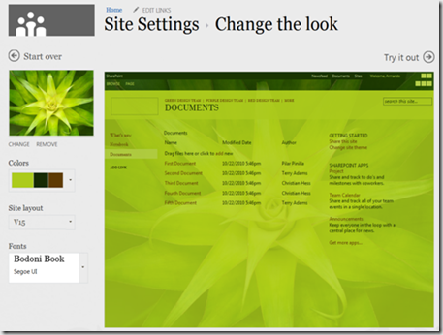
Theme based modifications
Flexible configuration
Colors
Site Layout
Fonts
Background Image
You can also preview these changes…

Slide 34
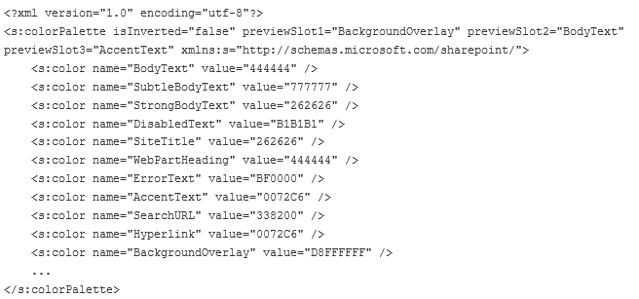
How themes are defined
New and simple set of XML formats
SPColor files describe the color palette
SPFont files describe the font scheme
Specify New Page Layout
Select New Master Page
Specify New Background Image
SP Color

Slide 35
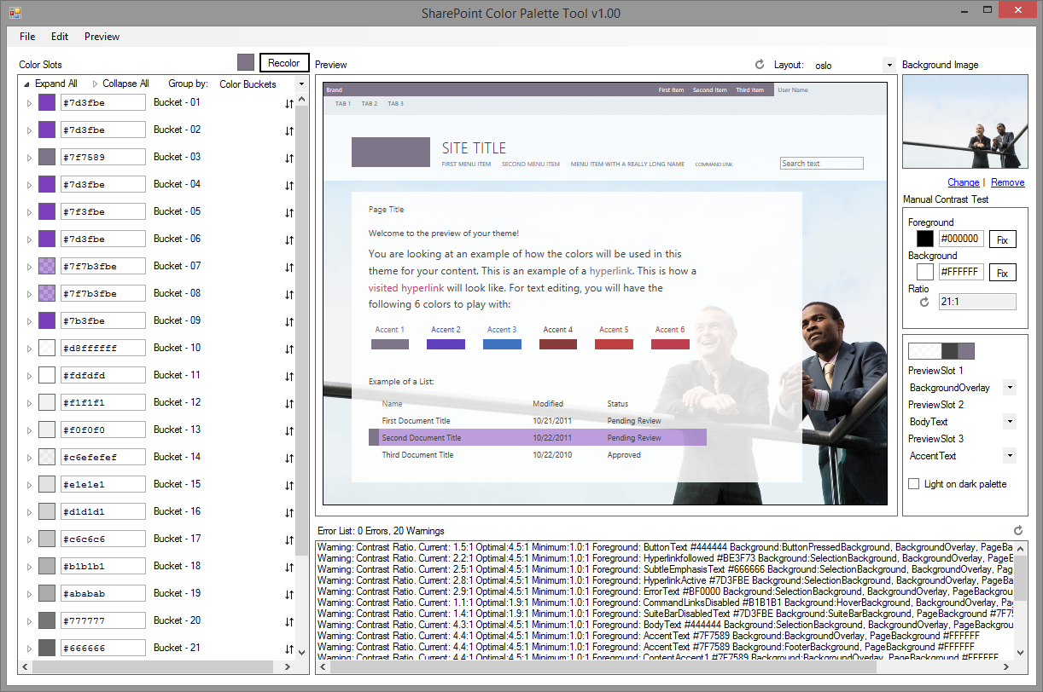
SharePoint Color Palette Tool v1.00
Free downloadable tool to create custom themes based on branding requirements
Notes:
http://www.microsoft.com/en-us/download/confirmation.aspx?id=38182

Slide 36
Use themes when possible
Themes are more future friendly than custom master pages…
Why?
Notes:
When we tar

Slide 37
Theme vs. master page
Theme
Can be introduce to bring color, font and background image settings
Sites with themes will still use out of the box master pages, so any updates will be automatically impacted to sites
Future major version upgrades don’t cause additional costs
Custom Master Page
Can introduce any level of customizations
When new changes are introduced to the out of the box master, those should be copied to custom master pages as well
Additional maintenance burden
Future major version upgrades will cause additional requirements to re-create the end user experience

Slide 38
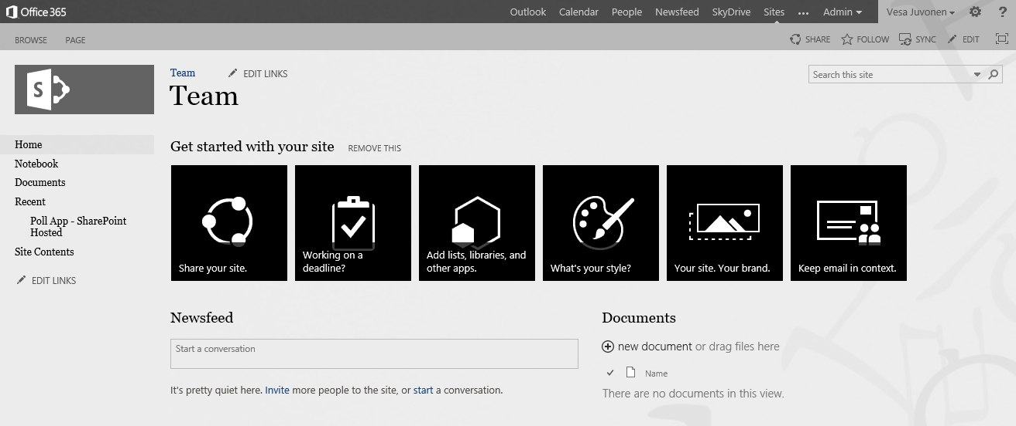
Handling themes from SP Apps
1
CSOM
3
Upload needed files
Set theme to site
(Set master page to site)
Theme elements
2
Color file
Font file
Background image
(Master page)
Notes:
App is started from the web by end user or process is started during provisioning
App side has the needed theme elements and other assets for sites, which will be published
App drives the modification of the host web by applying the needed customizations to host web

Slide 39
Theme
Demo

Slide 40
Update branding on existing sites

Slide 41
Updating Branding on existing Sites
What
Update branding and other settings in the sites after they are created based on new requirements
Why
It’s common that there has to be some adjustment done to the site sites, which have been previously created
How
Provision shared static elements like images, CSS files, and JavaScript files to one location and reference them from sites as needed with relative path
Loop through the sites and update them one by one using remote provisioning model

Slide 42


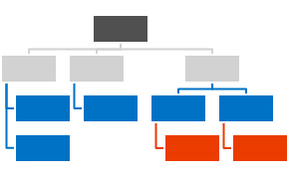
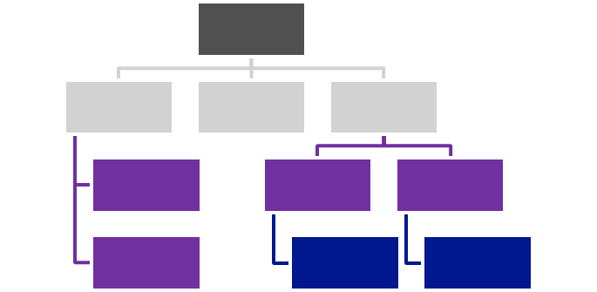




Centralized Asset Deployment
https://Contoso.sharepoint.com /sites/site
https://Contoso.sharepoint.com
<<Reference>>
3
https://Contoso.sharepoint.com /sites/site2
1
<<Reference>>
2
<<Reference>>
Assets and Configuration
https://Contoso.sharepoint.com /sites/site3
Branding Images
Master Pages
Page Layouts
Other settings
Notes:
Static assets like images, JS files, and CSS files are deployed together with the master page and asp files to the root site collection of the a web application or a tenant.
Dynamic files like master pages and other asp pages are deployed to the each site collections.
Static files are referenced from the root site collection using relative links.
Provides one location to change most of the functionalities and there’s no need to deploy all the image, CSS, or JS files to each of the site collection.

Slide 43
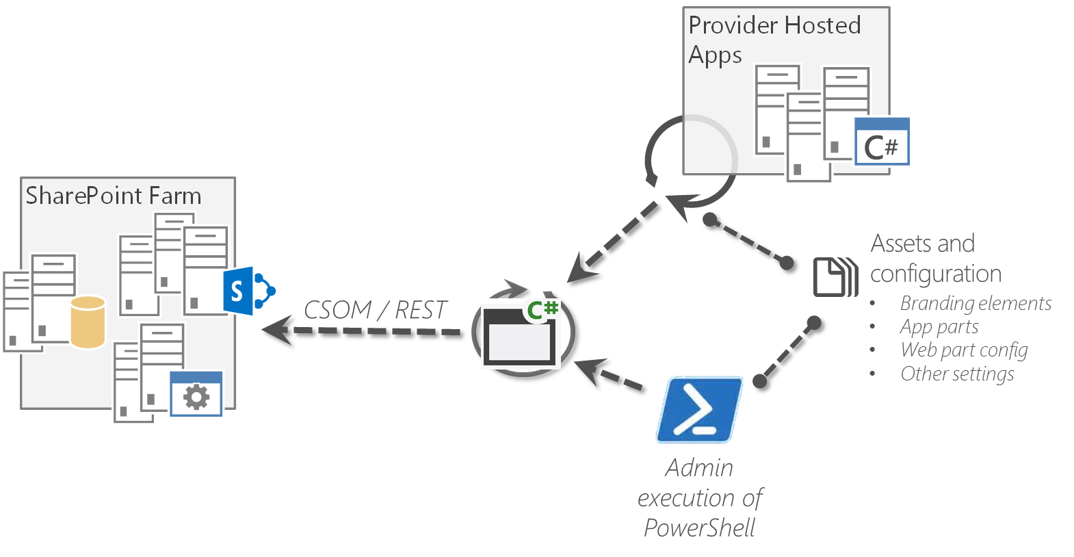
Updating Branding Afterwards Reference architecture
Place logic to reusable component, which can be called from the app and from other solution
Provides reusability and easy maintenance

Slide 44
Update branding on existing sites
Demo

Slide 45
Other site modifications JS injection

Slide 46
Introduction to JS injection pattern
What
Add custom action and needed JavaScript file to modify the end user experience
Why
Modify end user experience without changing the master page to avoid
How
Using user custom action capability introduced originally in SP2010 to add additional JavaScript file or script to be executed during the page execution
Notes:
Title: Introduction to JS injection pattern
Time: 1 minute

Slide 47
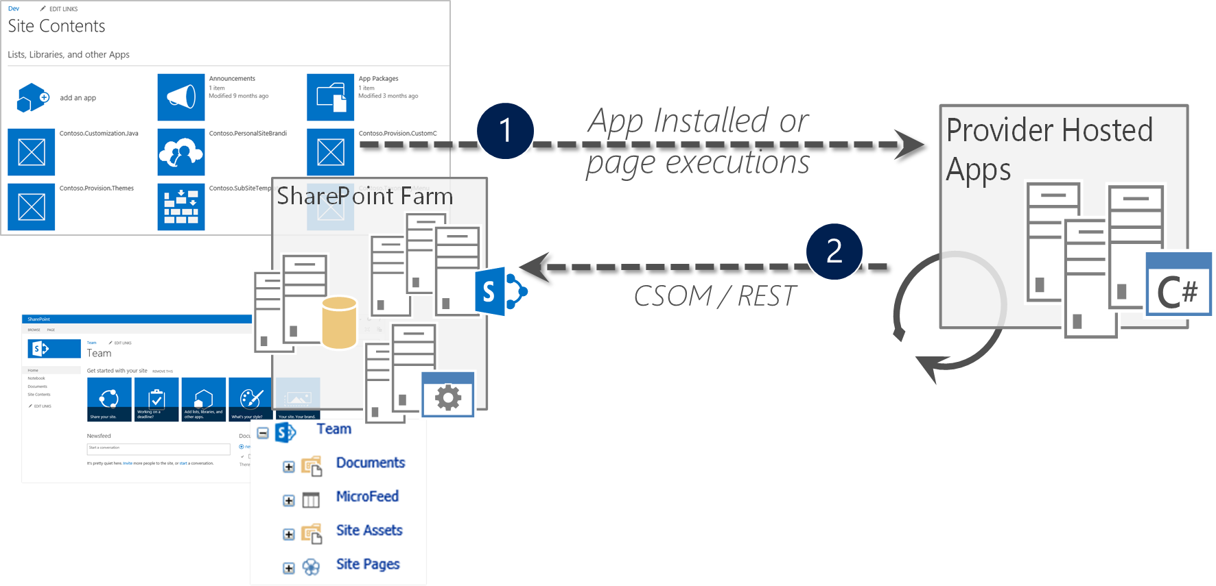
Using JS injection pattern
Handle App Installed event in provider hosted app
Upload needed JavaScript file to the host web
Create custom user action and inject that to site request process

Slide 48
Example code for injection
public void AddJSInjectionToSite(ClientContext clientContext)
{
// Upload JS file to host web
DeployJSInjectionFilesToContextWeb(clientContext, "~site/customfolder/mycustom.js”);
// Delete old entry if exists for same name and add new entry to the site
if (!CustomActionForJSInjectionAlreadyExists(clientContext))
{
UserCustomAction action = clientContext.Web.UserCustomActions.Add();
action.ScriptSrc = "~site/customfolder/mycustom.js";
action.Location = "ScriptLink";
action.Name = “mycustomjs";
action.Sequence = 1000;
action.Update();
clientContext.ExecuteQuery();
}
}

Slide 49
Other site modifications - JS injection
Demo

Slide 50
Other site modifications Wiki page modifications

Slide 51
Introduction to wiki page modifications
What
Create additional wiki pages or modify existing pages. On a page you can insert a HTML snippet or a web part / app part
Why
Inserting a web part or HTML snippet is a simple but powerful way to show data on a page
How
Using code that understands the “page-layout” model of wiki pages and allows for injection of a web part or HTML snippet into a cell of the wiki page “page-layout”

Slide 52
Example code for Wiki page modifications
// Add a simple single cell wiki page with some HTML content
string scenario1Page = String.Format("scenario1-{0}.aspx", DateTime.Now.Ticks);
string scenario1PageUrl = cc.Web.AddWikiPage("Site Pages", scenario1Page);
cc.Web.AddHtmlToWikiPage("SitePages", “<B>HTML snippet</B>" , scenario1Page);
// Add a “layout” to a wiki page
cc.Web.AddLayoutToWikiPage("SitePages", WikiPageLayout.TwoColumnsHeaderFooter, scenario2Page);
// Add a web part to a cell in a wiki page (row 2, column 1)
WebPartEntity wp2 = new WebPartEntity();
wp2.WebPartXml = "Web part XML"
wp2.WebPartIndex = 1;
wp2.WebPartTitle = "Links";
cc.Web.AddWebPartToWikiPage("SitePages", wp2, scenario2Page, 2, 1, false);

Slide 53
Other site modifications - wiki page modifications
Demo

Slide 54
What about OneDrive for Business branding?
Personal OneDrive for Business site is created automatically for the person when they visit my site first time…
Functionality previously known as my site, personal site or SkyDrive Pro

Slide 55
Manipulating OneDrive for Business sites
What
Modify personal OneDrive for Business sites automatically for end users
Why
Provide branding, document management features or other configurations to the sites
How
Can be achieved by accessing the personal OneDrive for Business site using social CSOM and then injecting the needed configurations to the site

Slide 56
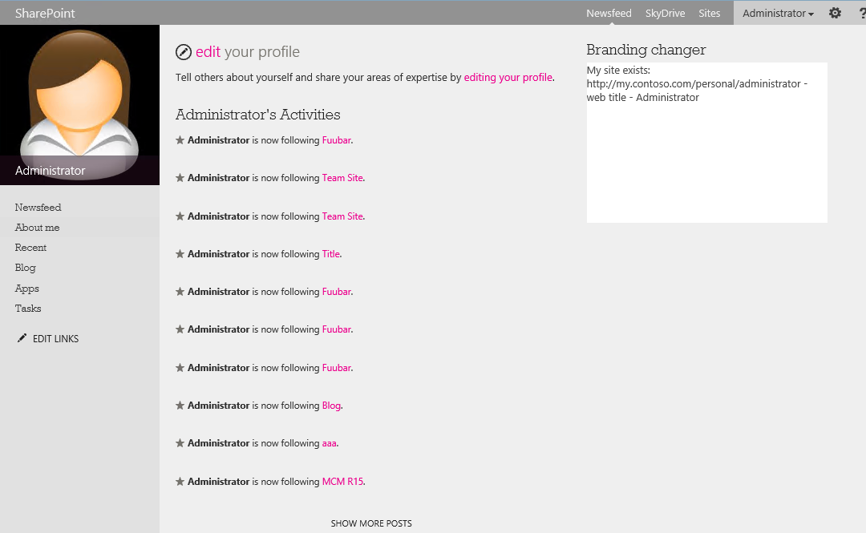
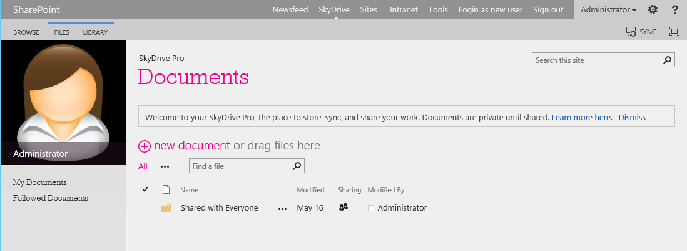
OneDrive for Business branding with remote provisioning
1
2
CSOM / REST
Branding elements
3
Color file
Font file
Background image
(Master page)
4

Slide 57
Example code for accessing OneDrive
// Get user profile
ProfileLoader loader = ProfileLoader.GetProfileLoader(clientContext);
UserProfile profile = loader.GetUserProfile();
Microsoft.SharePoint.Client.Site personalSite = profile.PersonalSite;
// Get instance to personal site collection and to root web
clientContext.Load(personalSite);
clientContext.ExecuteQuery();
Web rootWeb = personalSite.RootWeb;
clientContext.Load(rootWeb);
clientContext.ExecuteQuery();
// Now we have access to root web and can modify it as needed

Slide 58
OneDrive for Business modifications
Demo

Slide 59
Alternatives?
Pre-provision sites and apply branding before end users accesses the sites…

Slide 60

Remote timer job based customization for OD4B
Check for new site collections which have not yet been processed and apply when you find.
C#
Remote Timer job
2
1

Slide 61


© 2014 Microsoft Corporation. All rights reserved. Microsoft, Windows, and other product names are or may be registered trademarks and/or trademarks in the U.S. and/or other countries.
The information herein is for informational purposes only and represents the current view of Microsoft Corporation as of the date of this presentation. Because Microsoft must respond to changing market conditions, it should not be interpreted to be a commitment on the part of Microsoft, and Microsoft cannot guarantee the accuracy of any information provided after the date of this presentation. MICROSOFT MAKES NO WARRANTIES, EXPRESS, IMPLIED OR STATUTORY, AS TO THE INFORMATION IN THIS PRESENTATION.

